Slide 1
Data Mining 2 Supervised Learning
PERCEPTRONS
Dr. Shailesh Kumar
ISB/CBA

Slide 2
Quick Recap

Slide 3
From Data to Decisions…
Insights
Features
Domain Knowledge
Models
Data
Predictions
Decision
Business Objectives
Business Constraints
Feedback

Slide 4
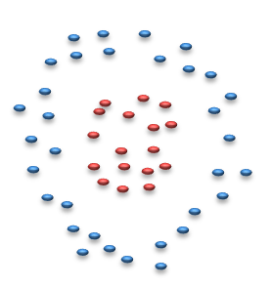
Two types of Classifiers
Descriptive
Learn class SHAPES
Bayesian Classifiers
Nearest Neighbor
Parzen Window
Discriminative
Learn class SEPARATORS
Decision Trees
Neural Networks,
Support Vector Machines

Slide 5
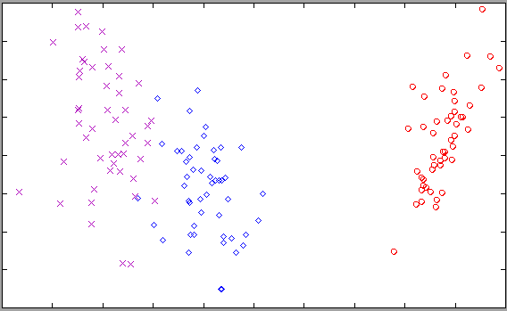
IRIS – Descriptive Classifier

Slide 6
IRIS – Discriminative Classifier

Slide 7
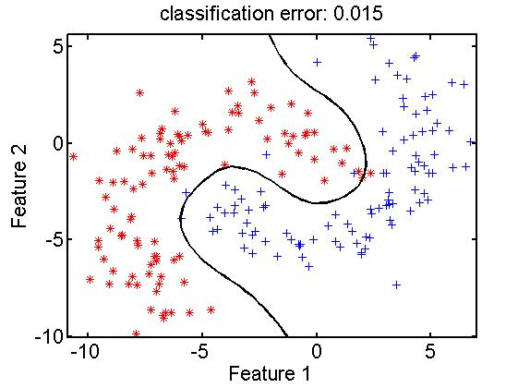
Transformation / Partition / Purity
Purity
Region - 1
Decision Boundary
Region - 2
Transformation

Slide 8
Bias – Variance Tradeoff

Slide 9
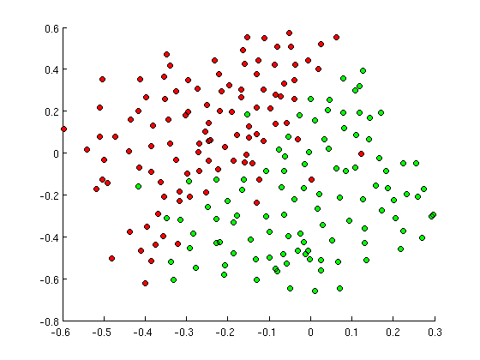
SIMPLE Decision Boundary?

Slide 10
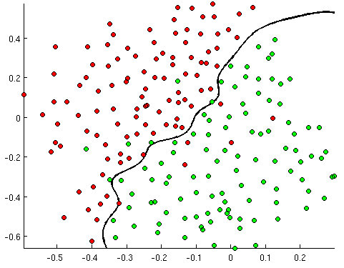
MEDIUM Decision Boundary!

Slide 11
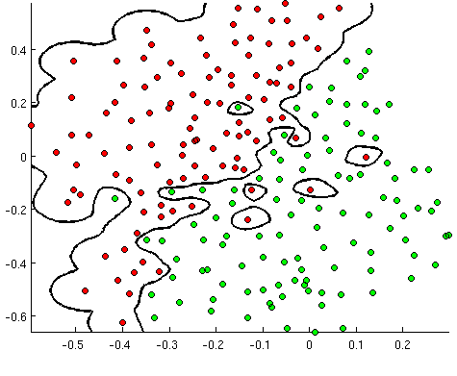
COMPLEX Decision Boundary!

Slide 12
Model SIGNAL not NOISE
Model is too simple → UNDER LEARN
Model is too complex → MEMORIZE
Model is just right → GENERALIZE

Slide 13
Generalize, don’t Memorize!
Training Set Accuracy
Right Level of Model Complexity
Model Accuracy
Validation Set Accuracy
Model Complexity

Slide 14
Bias Variance “Tradeoff”
Ideal Model
Expected Model that can be built from training data
Models built from different “samples” of training data and initializations
Possible models we “can” build given the “model capacity”
BIAS²
VARIANCE

Slide 15
Linear Classifier – 1 Linear Discriminant Analysis (Bayesian)

Slide 16
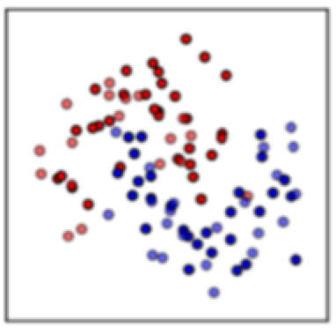
Linear Discriminant Analysis

Slide 17
Linear Discriminant Analysis

Slide 18
Linear Classifier – 2 Perceptron (Neuroscience)

Slide 19
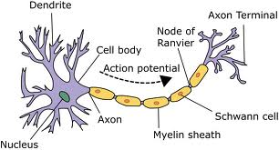
Neuron - the building block of the Brain

Slide 20
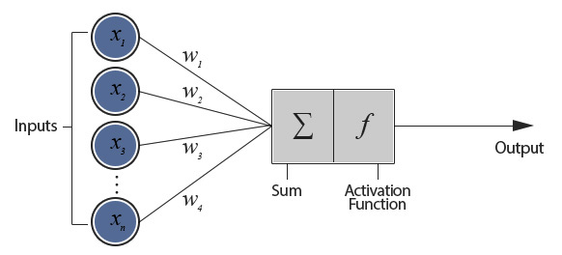
A Perceptron – A Mathematical model of Neuron

Slide 21
A neuron = a Hyperplane

Slide 22
A (hyper) plane

Slide 23
A (hyper) plane

Slide 24
A (hyper) plane

Slide 25
A (hyper) plane

Slide 26
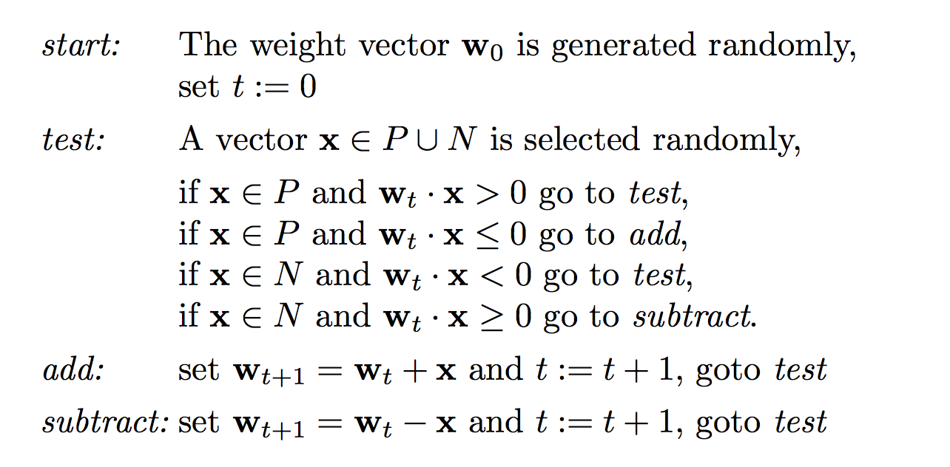
Perceptron – Learning Algorithm

Slide 27
What’s wrong with a Perceptron?
Does it depend on starting condition?
Does it depend on the order in which data is presented?
Is it ”robust” to the training data noise?
Is it hard or soft?

Slide 28
Linear Classifier – 3 Logistic Regression (Statistics)

Slide 29
Bernoulli Trials (101)

Slide 30
A (hyper) plane

Slide 31
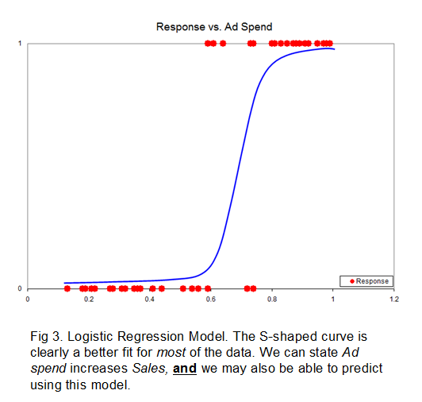
Linear Regression vs Discriminant

Slide 32
Interpretations of Logistic

Slide 33
Perceptron vs. Logistic Regression

Slide 34
Perceptron
HARD Decision:
Non-Differentiable – hard to do gradient descent
Not robust to Noise.

Slide 35
Logistic Regression
SOFT Decision:
Beautifully Differentiable – amenable to gradient descent
Robust to noise in data, Optimizes “gracefully”!

Slide 36
Learning in Perceptron vs. LR
PERCEPTRON
LOGISTIC REGRESSION

Slide 37
Discriminant functions
Linear Discriminant
Logistic Regression
Generalized Linear Discriminant

Slide 38
Model Analogies!
K-Means : Mixture-of-Gaussians ::
k-Nearest Neighbor : ??????
K-Nearest Neighbor : Parzen Window ::
Perceptron : ?????????
Uni-Modal Bayesian : Mixture-of-Gaussians Bayesian :: Logistic Regression :: ??????????

